Slide 1
Chapter 1
Introduction
* Most of the slides are from the authors

Slide 2
1.0 BACKGROUND

Slide 3
Why study logic design?
it is the implementation basis for all modern computing devices
  building large things from small components
  provide a model of how a computer works
More important reasons
  the inherent parallelism in hardware is often our first exposure to parallel computation
  it offers an interesting counterpoint to software design and is therefore useful in furthering our understanding of computation, in general

Slide 4
Applications of logic design
Conventional computer design
  CPUs, busses, peripherals
Networking and communications
  phones, modems, routers
Embedded products
  in cars, toys, appliances, entertainment devices
Scientific equipment
  testing, sensing, reporting
The world of computing is much bigger than just PCs!

Slide 5
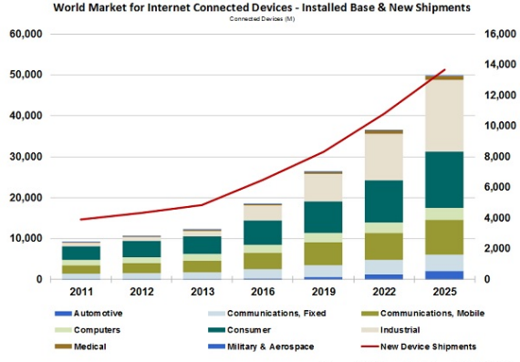
Connected device market
(processor/controller inside!)
Source: IHS
Computers constitute a small portion of the market!

Slide 6
1.1 DISSECTING THE TITLE

Slide 7
What is design? (1/2)
Design is the process of coming up with a solution to a problem
  Engineering, art,…
What is needed for design?
  Understand the problem
    Requirements: functional vs. non-functional (e.g., performance)
  Understand the constraints
    E.g., criteria for size, cost, power, beauty, etc.
For a complex problem, a divide-and-conquer approach
  E.g., dividing a building into constituent components
    Office layouts, window frames, ventilation systems etc.
  E.g., India and Pakistan

Slide 8
What is design? (2/2)
Software design
  Hardware platform imposes a limitation
  Break down software into pieces
  Reuse utilities
  Put together all the pieces
Designing a complex system requires a design methodology
Design methodology
  Domain-specific formalization of the design process into a set of well understood steps
  Three facets: creativity, tradeoff (decisions among alternatives), optimization
  Q: Tradeoffs in highway construction?
    Asphalt vs. cement
    A hill in the path

Slide 9
What is logic design? (1/2)
Digital hardware consists of components as well
Components or building blocks
  Switches built from semiconductor transistors
    Most basic element
  Higher level circuits such as logic gates and memories
  Switches and wires
A logic designer should choose the right component to solve logic design problems
Constraints: size, cost, performance, power consumption
  E.g., cost vs. size
* A circuit is an interconnected collection of switches

Slide 10
What is logic design? (2/2)
Each component has
  a set of input wires
  a set of output wires
  Each wire is set to some analog voltage value
    But will be interpreted as either 1 or 0 (digital abstraction)
Transistors react to the voltage levels on the input wires
  Switch their state and cause a change in output wires
  At macro scale, a component that contains transistors reacts to input voltage values
Depending on the way a circuit reacts to the input voltages
  Combinational logic circuits
  Sequential logic circuits

Slide 11
What is digital hardware?
Collection of devices that sense and/or control wires, which carry a digital value (i.e., a physical quantity that can be interpreted as a “0” or “1”)
  example: digital logic where voltage < 0.8v is a “0” and > 2.0v is a “1”
Primitive digital hardware devices
  logic computation devices (sense and drive)
    are two wires both “1” - make another be “1” (AND)
    is at least one of two wires “1” - make another be “1” (OR)
    is a wire “1” - then make another be “0” (NOT)
  memory devices (store)
    store a value
    recall a previously stored value
sense
AND
drive
sense

Slide 12
1.3 COMPUTATION

Slide 13
Computation: abstract vs. implementation
Computation has been a mental exercise (paper, programs)
This class is about physically implementing computation using physical devices that use voltages to represent logical values
Basic units of computation are:
  representation: "0", "1" on a wire
  set of wires (e.g., binary integer)
  assignment: x = y
  data operations: x + y – 5
  control:
  sequential statements: A; B; C
  conditionals: if (x == 1) then y;
  loops: for ( i = 1 ; i == 10; i++)
  procedures: A; proc(...); B;
We will study how each of these are implemented in hardware and composed into computational structures

Slide 14
Switches: basic element of physical implementations
Implementing a simple circuit
A
Z
close switch (if A is “1” or asserted)
and turn on light bulb (Z)
Z
A
open switch (if A is “0” or unasserted)
and turn off light bulb (Z)
Z ≡ A
Z and A are equivalent boolean variables

Slide 15
Switches (cont’d)
Compose switches into more complex ones (Boolean functions):
A
B
AND
Z ≡ A and B
A
OR
Z ≡ A or B
B

Slide 16
Switching networks
Switch settings
  determine whether or not a conducting path exists to light
  the light bulb
To build larger computations
  use a light bulb (output of the network) to set other switches (inputs to another network).
Connect together switching networks
  to construct larger switching networks, i.e., there is a way to connect outputs of one network to the inputs of the next.

Slide 17

A switch?
A mechanical switch
A semiconductor switch or transistor
In the earliest days of digital circuits, a relay is used to implement a switch

Slide 18
Relay networks
A simple way to convert between conducting paths and switch settings is to use (electro-mechanical) relays.
What is a relay?
  Relay = magnet + switch
  Both electric and mechanical properties
  The lower flexible half of the switch is made of ferric material
  Slow and large
* Ferric: 철분
<- Ferrum (Fe)
1
2
conducting
path composed
of switches
closes circuit
electromagnet
1. when no current flows, the spring of the contact
returns it to its normal position
2. current flowing through coil
magnetizes core and causes normally
closed (NC) contact to be pulled open

Slide 19
Transistor networks
Relays aren't used much anymore
  some traffic light controllers are still electro-mechanical
  Vacuum tubes are still large and unreliable
Modern digital systems are designed in CMOS technology
  MOS stands for Metal-Oxide on Semiconductor
  C is for complementary because there are both normally-open and normally-closed switches: nMOS and pMOS
MOS transistors act as voltage-controlled switches
  Similar to relay
  Smaller and faster than relay
* CMOS: complementary metal-oxide semiconductor

Slide 20
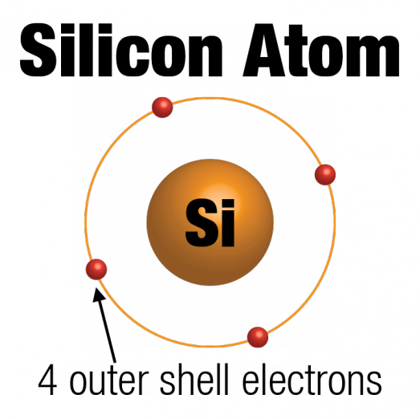
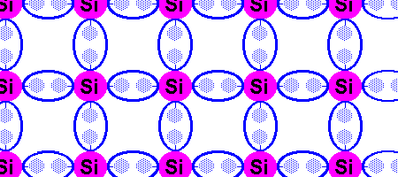
Silicon Lattice
Transistors are built on a silicon substrate
Silicon is a Group IV material
Forms crystal lattice with bonds to four neighbors
Just an insulator
Image source: RedArc
Image source: George Watson@ U. of Delaware

Slide 21
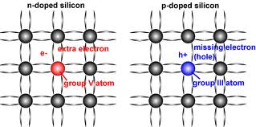
Dopants (materials for doping)
* dope: 불순물을 첨가하다
Silicon is a semiconductor
Pure silicon has no free carriers and conducts poorly
Adding dopants increases the conductivity
Group V: extra electron
  n-type: electrons >> holes
Group III: missing electron, called hole
  p-type: electrons << holes
* n-type from negative, p-type from positive
* As 비소 arsenic, Group 5
* B 붕소 boron, Group 3
Source: PV Education

Slide 22
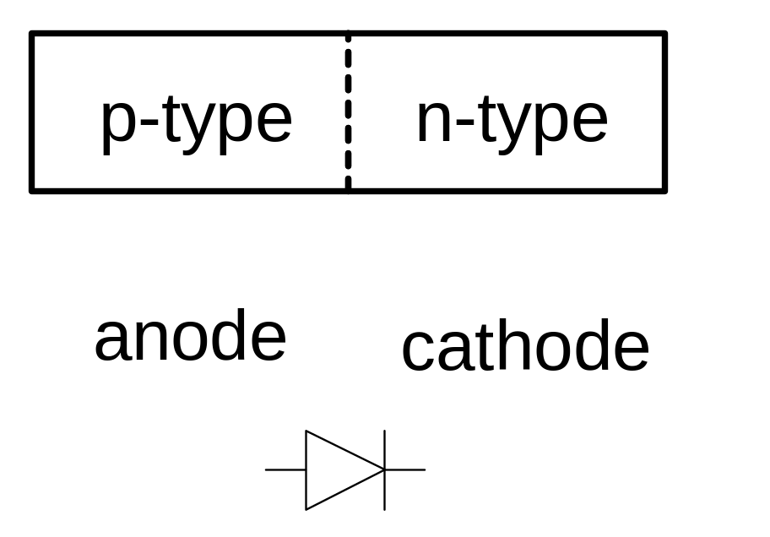
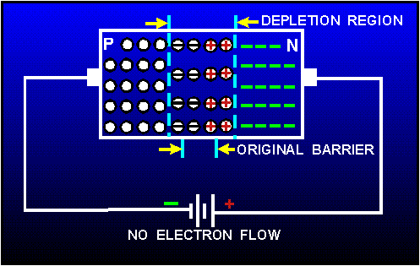
p-n Junctions
A junction between p-type and n-type semiconductor forms a diode.
Current flows only in one direction
+ V
- V
current
Anode: 양극 ana (up) + hodos (way)
Cathode: 음극 kata (down) + hodos (way)
Source: tpub.com

Slide 23
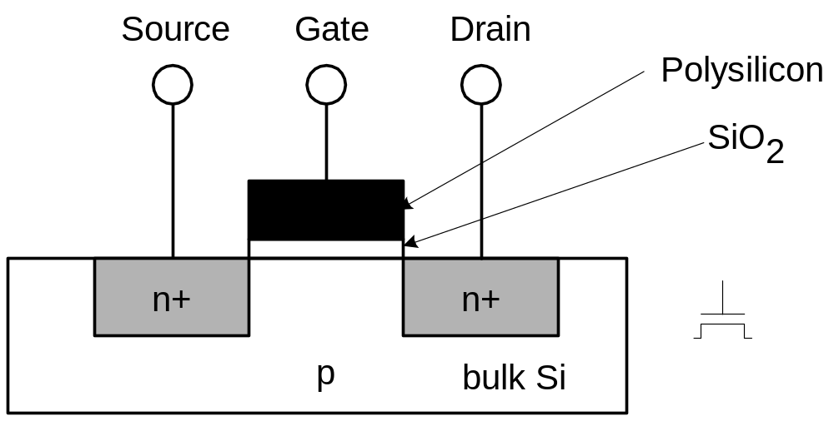
n-channel (or n-type) MOS (nMOS) circuit
Three terminals: source-gate-drain (or S-G-D for short)
three layers: polysilicon (used to be metal) – SiO2 - substrate
+V
* oxide 산화물
If G is at positive voltage, electrons in the substrate will move toward G terminal, which sets up a channel between S and D
  And D is at high voltage, current will flow from drain to source
Metal is replaced by polysilicon which is more adhesive
* n+: heavily doped n-type semiconductor

Slide 24
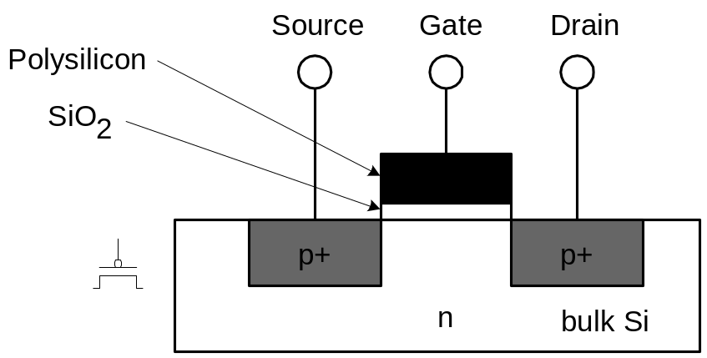
p-channel (or p-type) MOS (pMOS) circuit
Three terminals: source-gate-drain (or S-G-D for short)
Same principle, but reverse doping and voltage
  Source (Vss) is positive with regard to drain (Vdd)
Bubble indicates the inverted behavior
+V
If G is at positive voltage, the current does not flow
If G is at ground level, the current flows

Slide 25
MOS transistors
MOS transistors have three terminals: drain, gate, and source
  they act as switches in the following way:
  if the voltage on the gate terminal is (some amount) higher/lower than the source terminal, then a conducting path will be established between the drain and source terminals
G
G
S
D
S
D
n-channel
open when voltage at G is low
closed when voltage at G is high
p-channel
closed when voltage at G is low
open when voltage at G is high

Slide 26
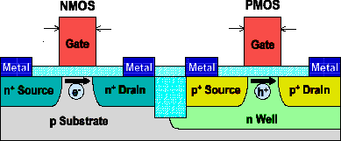
nMOS and pMOS are used in pair
nMOS and pMOS have complementary nature
  Why they are called complementary MOS (CMOS)
Source: 이조원@나노테크

Slide 27
MOS networks
X
what is the
relationship
between x and y?
3v
x
y
Y
0 volts
3 volts
0v
3 volts
0 volts
A simple component is made up of two transistors
  X: input
  Y: output
  What is this function?
In CMOS circuits, pMOS and nMOS are used in pair

Slide 28
Two input networks
X
Y
3v
what is the relationship
between x, y and z1/z2?
Z₁
0v
x
y
z1 z2
0 volts
0 volts
3 volts
3 volts
X
Y
0 volts
3 volts
3 volts
0 volts
3v
3 volts
0 volts
3 volts
0 volts
3 volts
3 volts
0 volts
0 volts
Z₂
NAND
NOR
0v

Slide 29
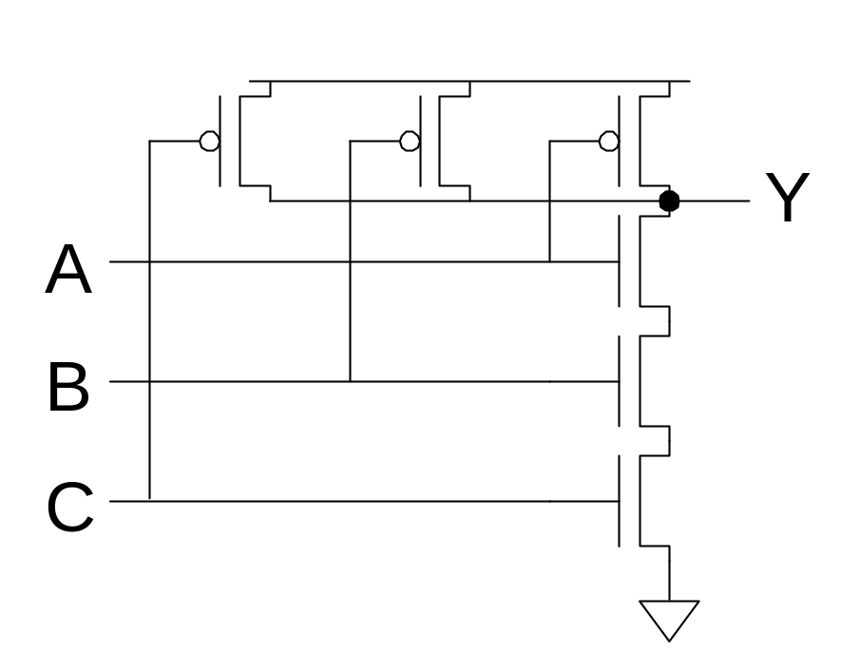
Three input NAND gate
Y pulls low if ALL inputs are 1
Y pulls high if ANY input is 0
V_{DD}
In general, the more inputs, the more transistors (TRs)
In CMOS, a variable requires a pair of TRs

Slide 30
Digital vs. analog
Convenient to think of digital systems as having only
discrete (or digital) input/output values
In reality, real electronic components exhibit
continuous, analog behavior
Why do we make the digital abstraction anyway?
  switches operate this way
  easier to think about a small number of discrete values
  Quantization error, though
Why does it work?
  does not propagate small errors in values
  always resets to 0 or 1
P.14

Slide 31
Mapping from physical world to binary world
Technology State 0 State 1
Relay logic Circuit Open Circuit Closed
CMOS logic 0.0-1.0 volts 2.0-3.0 volts
Transistor transistor logic (TTL) 0.0-0.8 volts 2.0-5.0 volts
Fiber Optics Light off Light on
Dynamic RAM Discharged capacitor Charged capacitor
Nonvolatile memory (erasable) Trapped electrons No trapped electrons
Programmable ROM Fuse blown Fuse intact
Magnetic disk No flux reversal Flux reversal
Compact disc No pit Pit

Slide 32
Combinational vs. sequential digital circuits
A simple model of a digital system is a unit with inputs and outputs:
Combinational means "memory-less"
  a digital circuit is combinational if its output values
  only depend on its (current) input values
inputs
system
outputs

Slide 33
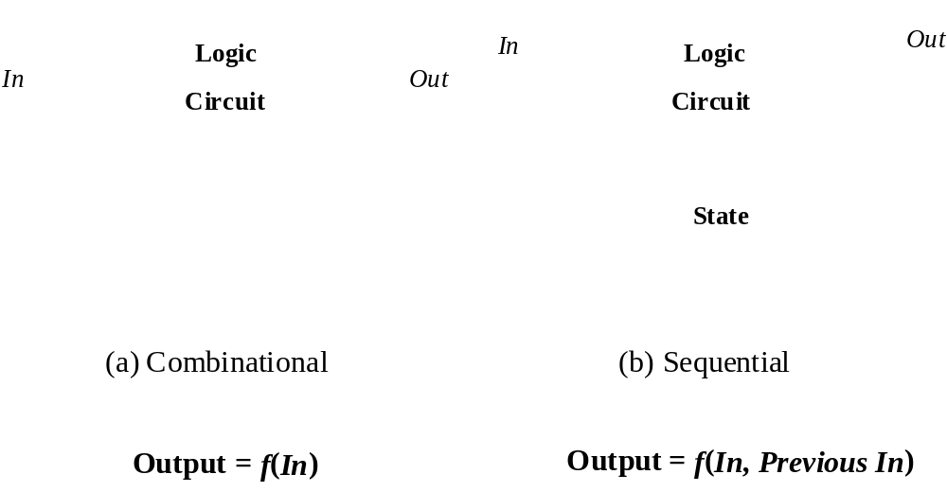
Combinational vs. sequential digital circuits

Slide 34






Combinational logic symbols
Common combinational logic systems have standard symbols called logic gates
  Buffer, NOT
  AND, NAND
  OR, NOR
A
Z
A
Z
easy to implement
with CMOS transistors
(the switches we have
available and use most)
B
A
Z
B

Slide 35
Sequential logic
Sequential systems
  exhibit behaviors (output values) that depend not only
  on the current input values, but also on previous input values
In reality, all real circuits are sequential
  because the outputs do not change instantaneously after an input change
  Timing is important
A fundamental abstraction of digital design is to reason (mostly) about steady-state behaviors
  look at the outputs only after sufficient time has elapsed for the system to make its required changes and settle down

Slide 36
Example of combinational and sequential logic
Combinational:
  input A, B
  wait for clock edge
  observe C
  wait for another clock edge
  observe C again: will stay the same
Sequential:
  input A, B
  wait for clock edge
  observe C
  wait for another clock edge
  observe C again: may be different
A
C
B
Clock

Slide 37
Abstractions
Some we've seen already
  digital interpretation of analog values
  transistors as switches
  switches as logic gates
  use of a clock to realize a synchronous sequential circuit
Some others we will see
  truth tables and Boolean algebra to represent combinational logic
  encoding of signals with more than two logical values into
  binary form
  state diagrams to represent sequential logic
  hardware description languages to represent digital logic
  waveforms to represent temporal behavior

Slide 38
1.4 examples

Slide 39
An example
Calendar subsystem: number of days in a month (to control watch display)
  Combinational logic
  used in controlling the display of a wrist-watch LCD screen
  inputs: month, leap year flag
  outputs: number of days

Slide 40
Implementation in software
integer number_of_days ( month, leap_year_flag)
{
  switch (month) {
    case 1: return (31);
    case 2: if (leap_year_flag == 1) then return (29)
    else return (28);
    case 3: return (31);
    ...
    case 12: return (31);
    default: return (0);
  }
}
Full version in P.16

Slide 41
Implementation as a combinational digital system
Encoding:
  how many bits for each input/output?
  binary number for month
  four wires for 28, 29, 30, and 31
Behavior:
  combinational
  truth table
  specification
Don’t care
month leap d28 d29 d30 d31
0000 – – – – –
0001 – 0 0 0 1
0010 0 1 0 0 0
0010 1 0 1 0 0
0011 – 0 0 0 1
0100 – 0 0 1 0
0101 – 0 0 0 1
0110 – 0 0 1 0
0111 – 0 0 0 1
1000 – 0 0 0 1
1001 – 0 0 1 0
1010 – 0 0 0 1
1011 – 0 0 1 0
1100 – 0 0 0 1
1101 – – – – –
111– – – – – –
month
leap
d28
d29
d30
d31

Slide 42
Combinational example (cont’d)
Truth-table to logic to switches to gates
  d28 = 1 when month=0010 and leap=0
  d28 = m8'•m4'•m2•m1'•leap'
  d31 = 1 when month=0001 or month=0011 or ... month=1100
  d31 = (m8'•m4'•m2'•m1) + (m8'•m4'•m2•m1) + ... (m8•m4•m2'•m1')
  d31 = can we simplify more?
symbol
for not
month leap d28 d29 d30 d31
0001 – 0 0 0 1
0010 0 1 0 0 0
0010 1 0 1 0 0
0011 – 0 0 0 1
0100 – 0 0 1 0
...
1100 – 0 0 0 1
1101 – – – – –
111– – – – – –
0000 – – – – –
symbol
for and
symbol
for or

Slide 43
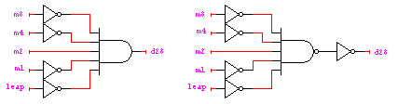
Combinational example (cont’d)
d28 = m8'•m4'•m2•m1'•leap’
d29 = m8'•m4'•m2•m1'•leap
d30 = (m8'•m4•m2'•m1') + (m8'•m4•m2•m1') +
(m8•m4'•m2'•m1) + (m8•m4'•m2•m1)
= (m8'•m4•m1') + (m8•m4'•m1)
d31 = (m8'•m4'•m2'•m1) + (m8'•m4'•m2•m1) +
(m8'•m4•m2'•m1) + (m8'•m4•m2•m1) +
(m8•m4'•m2'•m1') + (m8•m4'•m2•m1') +
(m8•m4•m2'•m1')

Slide 44
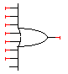
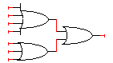
Combinational example (cont’d)
d28 = m8'•m4'•m2•m1'•leap’
d29 = m8'•m4'•m2•m1'•leap
d30 = (m8'•m4•m2'•m1') + (m8'•m4•m2•m1') +
(m8•m4'•m2'•m1) + (m8•m4'•m2•m1)
d31 = (m8'•m4'•m2'•m1) + (m8'•m4'•m2•m1) +
(m8'•m4•m2'•m1) + (m8'•m4•m2•m1) +
(m8•m4'•m2'•m1') + (m8•m4'•m2•m1') +
(m8•m4•m2'•m1')
d31
d31
* d31 can be implemented in different ways

Slide 45
Another example (Door combination lock)
punch in 3 values in sequence and the door opens; if there is an error the lock must be reset; once the door opens the lock must be reset
  Sequential logic
  inputs: sequence of input values, reset
    Numeric number: 4 wires
  outputs: door open/close
  memory: must remember combination
  or always have it available as an input

Slide 46
Implementation in software
integer combination_lock ( ) {
  integer v1, v2, v3;
  integer error = 0;
  static integer c[3] = {3, 4, 2};
  while (!new_value( ));
  v1 = read_value( );
  if (v1 != c[1]) then error = 1;
  while (!new_value( ));
  v2 = read_value( );
  if (v2 != c[2]) then error = 1;
  while (!new_value( ));
  v3 = read_value( );
  if (v2 != c[3]) then error = 1;
  if (error == 1) then return(0); else return (1);
}
Assume array index starts from 1
P.19, 20

Slide 47
Implementation as a sequential digital system
Encoding:
  how many bits per input value?
  how many values in sequence?
  how do we know a new input value is entered?
  how do we represent the states of the system?
Behavior:
  clock wire tells us when it’s ok
  to look at inputs
  (i.e., they have settled after change)
  sequential: sequence of values
  must be entered
  sequential: remember if an error occurred
  finite-state specification
new
value
reset
state
clock
open/closed

Slide 48
Sequential example (cont’d): abstract control
Finite-state diagram
  states: 5 states
    represent point in execution of machine
    each state has inputs and outputs
  transitions: 6 from state to state, 5 self transitions, 1 global
    changes of state occur when clock says it’s ok
    based on value of inputs
  inputs: reset, new, results of comparisons
  output: open/closed
ERR
closed
C1!=value
& new
C2!=value
& new
C3!=value
& new
S1
S2
S3
OPEN
reset
closed
closed
closed
open
C1=value
& new
C2=value
& new
C3=value
& new
not new
not new
not new

Slide 49
Sequential example (cont’d): data-path vs. control
Internal structure
  data-path
    storage for combination
    comparators
  control
    finite-state machine controller
    control for data-path
    state changes controlled by clock
new
equal
reset
value
C1
C2
C3
mux
control
multiplexer
controller
clock
comparator
equal
open/closed
* Multiplexer (MUX)

Slide 50
Sequential example (cont’d): FSM
Finite-state machine (FSM)
  refine state diagram to include internal structure
ERR
closed
not equal
& new
not equal
& new
not equal
& new
S1
S2
S3
OPEN
reset
closed
mux=C1
closed
mux=C2
closed
mux=C3
open
equal
& new
equal
& new
equal
& new
not new
not new
not new

Slide 51
Sequential example (cont’d): FSM
Finite-state machine
  generate state table (much like a truth-table)
ERR
closed
not equal
& new
not equal
& new
not equal
& new
S1
S2
S3
OPEN
reset
closed
mux=C1
equal
& new
closed
mux=C2
equal
& new
closed
mux=C3
equal
& new
open
next
reset new equal state state mux open/closed
1 – – – S1 C1 closed
0 0 – S1 S1 C1 closed
0 1 0 S1 ERR – closed
0 1 1 S1 S2 C2 closed
0 0 – S2 S2 C2 closed
0 1 0 S2 ERR – closed
0 1 1 S2 S3 C3 closed
0 0 – S3 S3 C3 closed
0 1 0 S3 ERR – closed
0 1 1 S3 OPEN – open
0 – – OPEN OPEN – open
0 – – ERR ERR – closed
not new
not new
not new
* state is not input, but internal variable

Slide 52
Sequential example (cont’d): encoding
Encode state table
  state can be: S1, S2, S3, OPEN, or ERR
    needs at least 3 bits to encode: 000, 001, 010, 011, 100
    and as many as 5: 00001, 00010, 00100, 01000, 10000
    choose 4 bits: 0001, 0010, 0100, 1000, 0000
  output mux can be: C1, C2, or C3
    needs 2 to 3 bits to encode
    choose 3 bits: 001, 010, 100
  output open/closed can be: open or closed
    needs 1 or 2 bits to encode
    choose 1 bits: 1, 0

Slide 53
Sequential example (cont’d): encoding
Encode state table
  state can be: S1, S2, S3, OPEN, or ERR
    choose 4 bits: 0001, 0010, 0100, 1000, 0000
  output mux can be: C1, C2, or C3
    choose 3 bits: 001, 010, 100
  output open/closed can be: open or closed
    choose 1 bits: 1, 0
Internal input
system’s
or external output
Internal output
next
reset new equal state state mux open/closed
1 – – – 0001 001 0
0 0 – 0001 0001 001 0
0 1 0 0001 0000 – 0
0 1 1 0001 0010 010 0
0 0 – 0010 0010 010 0
0 1 0 0010 0000 – 0
0 1 1 0010 0100 100 0
0 0 – 0100 0100 100 0
0 1 0 0100 0000 – 0
0 1 1 0100 1000 – 1
0 – – 1000 1000 – 1
0 – – 0000 0000 – 0
external input
good choice of encoding!
mux is identical to
last 3 bits of next state
open/closed is
identical to first bit
of state

Slide 54
Sequential example (cont’d): controller implementation
Implementation of the controller
special circuit element, called a register, for
remembering inputs when told to by clock
new
equal
reset
mux
control
controller
new
equal
reset
clock
mux
control
comb. logic
open/closed
state
clock
open/closed

Slide 55
Design hierarchy
system
data-path
control
code
registers
multiplexer
comparator
state
registers
combinational
logic
register
logic
switching
networks

Slide 56
Further Remarks

Slide 57
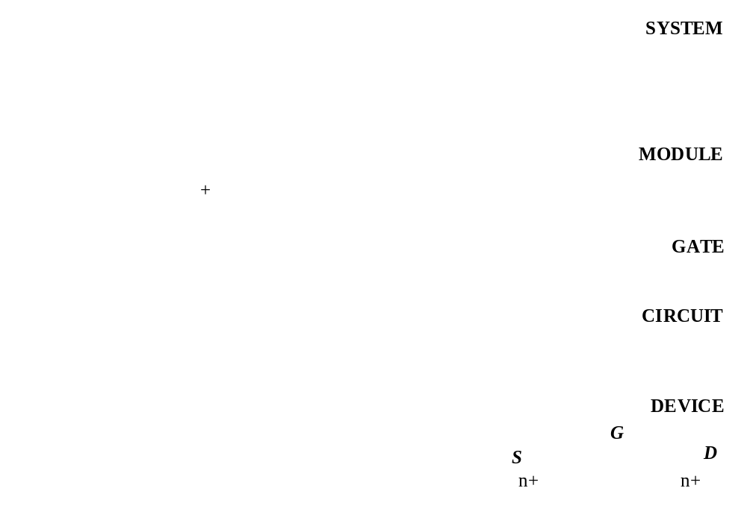
terminologies

Slide 58
Summary
That was what the entire course is about
  converting solutions (to problems) into combinational and sequential networks effectively organizing the design hierarchically
  doing so with a modern set of design tools that lets us handle large designs effectively
  taking advantage of optimization opportunities

